Slide 1
Mcp Rearrange
1. We set the Mcp Row = 4 and Column = 4
2. For geometric reconstruction, events = 4000, for time imaging reconstruction, events = 50,000
01

Slide 2
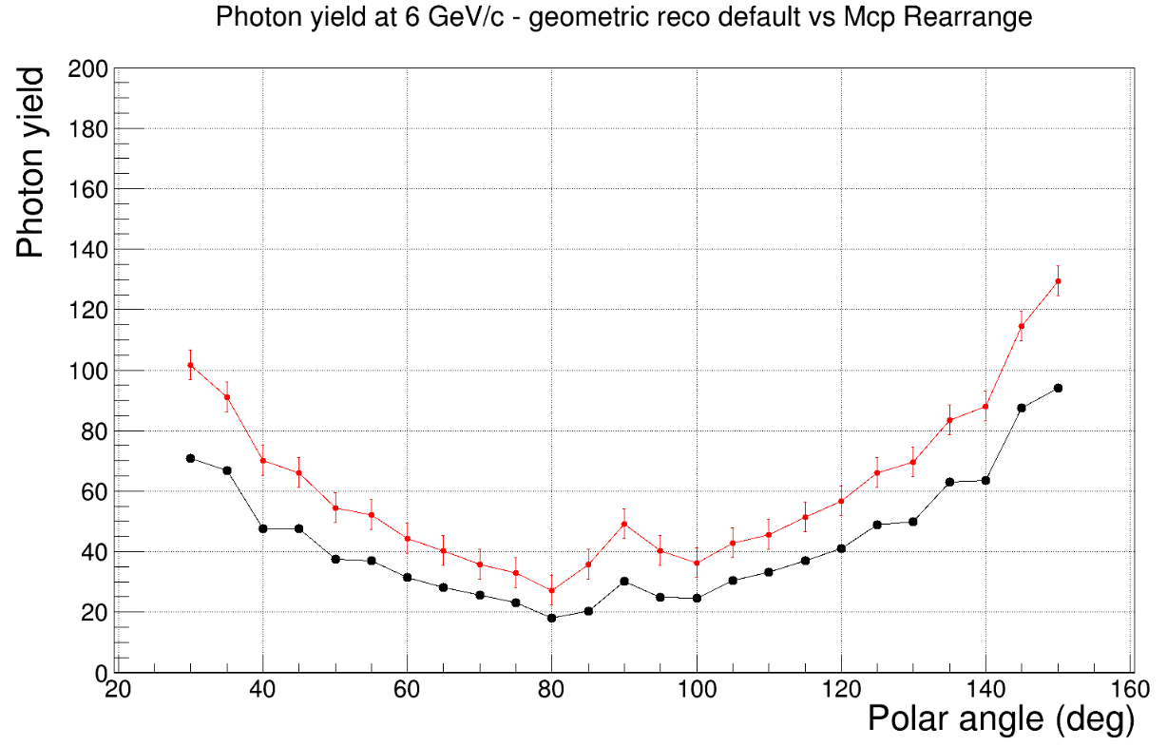
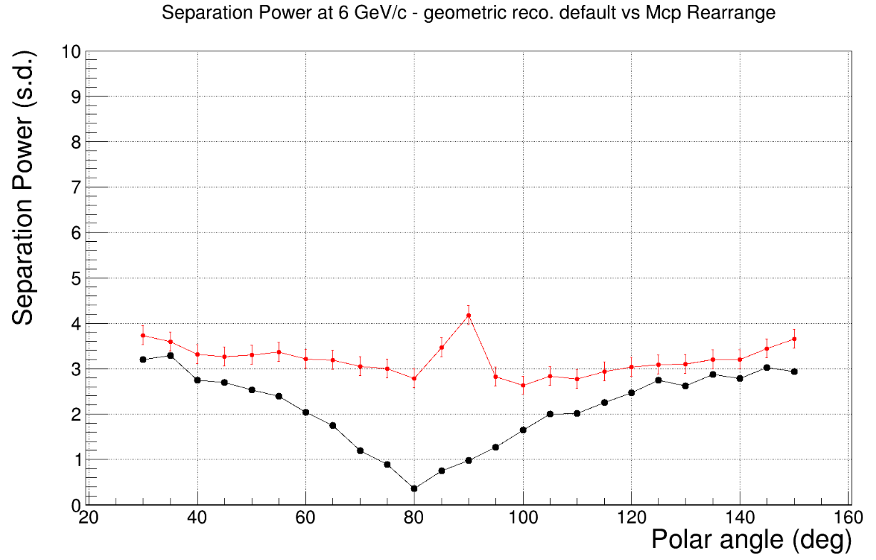
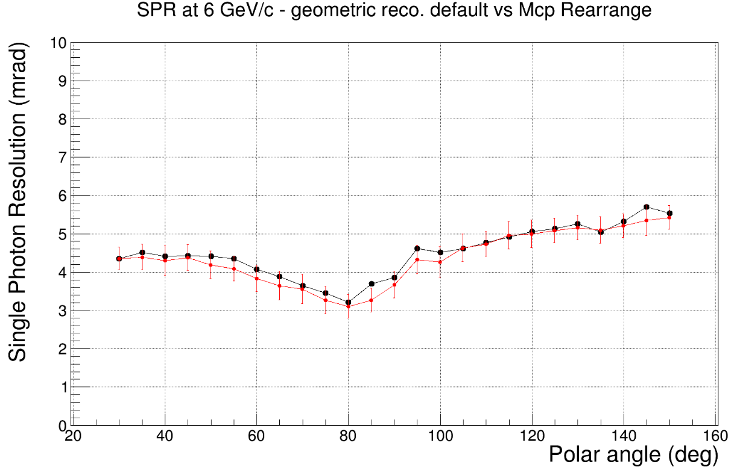
Default 6 x 4
Mcp 4 x 4
02

Slide 3
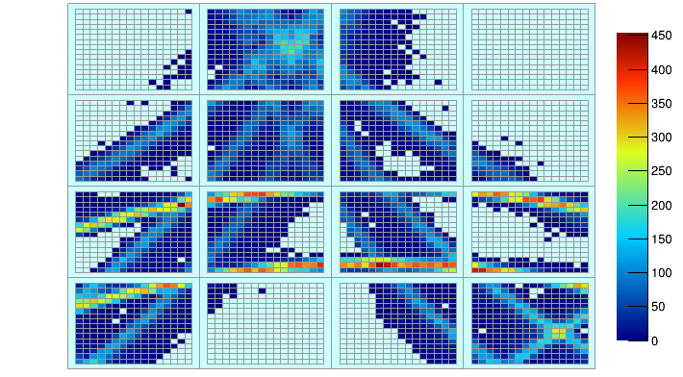
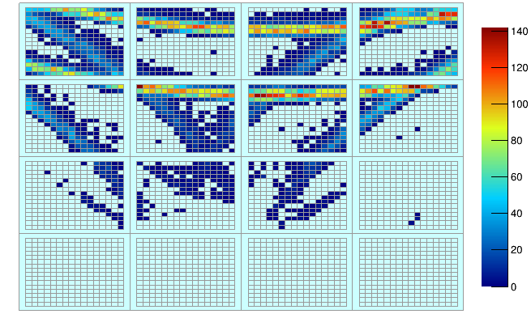
Hp for 80 degree polar angle
Hp for 30 degree polar angle
03

Slide 4
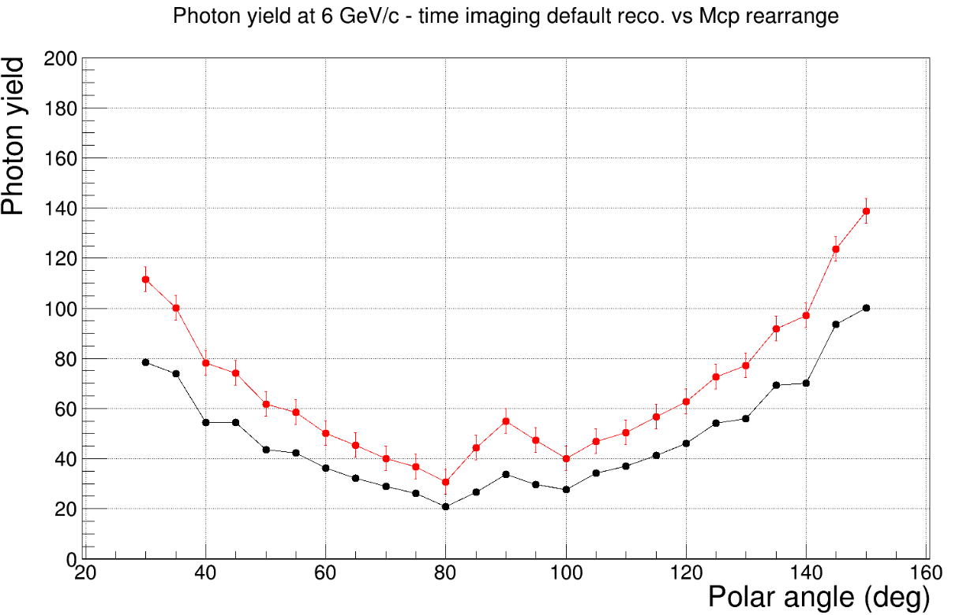
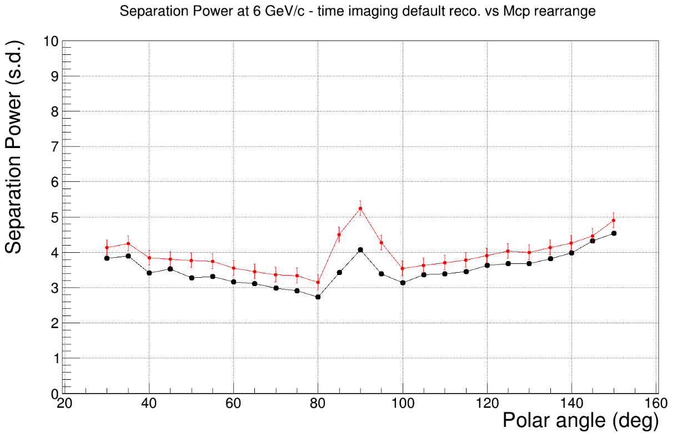
Default 6 x 4
Mcp 4 x 4
04

Slide 5
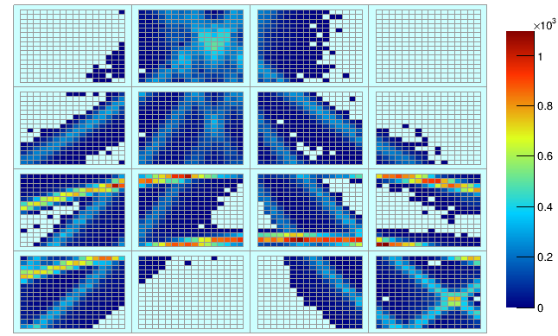
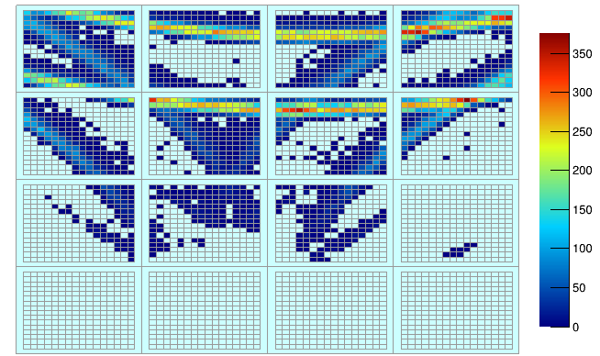
Hp for 30 degree polar angle
Hp for 80 degree polar angle
05

